Slide 1
Towards Scalable Complex Event Processing
Defeating the Exponentiality of
Event Pattern Detection

Slide 2
Overview
Complex event processing (CEP)
The reason CEP it difficult
Data-aware CEP
Lazy evaluation for CEP
Join methods for CEP
Adaptive CEP
Multi-Pattern CEP

Slide 3
Introduction

Slide 4
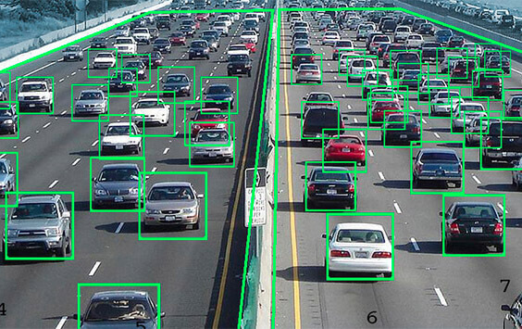

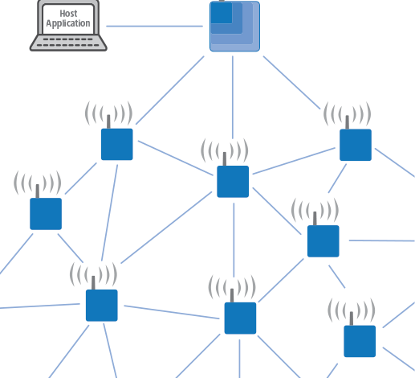


Complex Event Processing
Data items are viewed as primitive events
Primitive events are combined into complex events
Complex events conform to user-defined patterns
The goal: detect complex
events in the input stream(s)

Slide 5
CEP Applications
CEP Applications
Online Finance
Fraud Detection
Network Security Monitoring
Sensor Networks
Algorithmic Trading
Internet of Things
Stock Monitoring
Surveillance Systems

Slide 6
The history of CEP
Traditional DB
Static, mostly relational data
“Classic” SQL queries, joins, etc.
A well-established field since the 70s
Stream Processing
Data streams instead of tables
Tight real-time requirements
Very limited local memory
Mostly aggregation queries (heavy hitters, distinct items, etc. )
A data item is viewed as a primitive event
Primitive events are combined into complex events which conform to user-defined patterns
The goal is to detect complex event occurrences in the input stream(s)
Complex Event Processing

Slide 7
CEP Example – Security Surveillance System
a
b
b
b
a
b
b
a
a
c
a
c
a
a
c
d
d
d
d
SEQ(MainLobbyCameraEvent a,
CorridorCameraEvent b,
RestrictedAreaCameraEvent c)
WHERE (a.person_id == b.person_id == c.person_id)

Slide 8

CEP Example 2 – Monitoring Stock Prices
PATTERN SEQ(
AppleStockPriceUpdate a,
MicrosoftStockPriceUpdate b,
GoogleStockPriceUpdate c)
WHERE ((a.price < b.price) AND
(b.price < c.price))
WITHIN 10 minutes

Slide 9
Pattern Types in CEP
Conjunctions
all events specified in the pattern must occur
Disjunctions
at least one of the specified events must occur
Sequences
all events must occur in the predefined order
Kleene closure
some events may appear an unlimited number of times
Negations
some events are prohibited from occurring at the specified positions
Nested patterns
arbitrary combinations of all of the above
Notes:
Need examples in this slide for each pattern type
Ilya: examples come later, when I describe a NFA for each pattern type.

Slide 10
CEP Evaluation Mechanisms
Non-deterministic Finite Automata
Evaluation Trees
and more..

Slide 11
NFA for Example 2
ignore b,c
ignore a,c
ignore a,b
Q1
take a
Q2
Q3
F
take b
take c
a.price < b.price
b.price < c.price
SEQ(AppleStockPriceUpdate a, MicrosoftStockPriceUpdate b,
GoogleStockPriceUpdate c)
WHERE ((a.price < b.price) AND (b.price < c.price))
WITHIN 10 minutes

Slide 12
NFA-Based Detection Example
a₁^{p=1}
a₂^{p=1}
a₃^{p=4}
b₁^{p=7}
b₂^{p=9}
b₃^{p=5}
c₁^{p=6}
a₁
a₂
a₁b₃ с₁
a₃
a₁b₁
a₂b₃ с₁
a₂b₁
a₃b₁
a₁b₂
a₃b₃ с₁
a₂b₂
a₃b₂
a₁b₃
SEQ(AppleStockPriceUpdate a, MicrosoftStockPriceUpdate b,
GoogleStockPriceUpdate c)
WHERE ((a.price < b.price) AND (b.price < c.price))
WITHIN 10 minutes
a₂b₃
a₃b₃

Slide 13
Evaluation Tree for Example 2
Root
SEQ(
AppleStockPriceUpdate a,
MicrosoftStockPriceUpdate b,
GoogleStockPriceUpdate c)
WHERE ((a.price < b.price) AND
(b.price < c.price))
WITHIN 10 minutes
b.price < c.price
A,B
C
a.price < b.price
A
B

Slide 14
Tree-Based Detection Example
a₁^{p=1}
a₂^{p=1}
a₃^{p=4}
b₁^{p=7}
b₂^{p=9}
b₃^{p=5}
c₁^{p=6}
a₁
b₁
a₂
b₂
a₁b₃ с₁
a₃
b₃
a₁b₁
a₂b₁
a₂b₃ с₁
a₃b₁
a₁b₂
c₁
a₃b₃ с₁
a₂b₂
a₃b₂
a₁b₃
SEQ(AppleStockPriceUpdate a, MicrosoftStockPriceUpdate b,
GoogleStockPriceUpdate c)
WHERE ((a.price < b.price) AND (b.price < c.price))
WITHIN 10 minutes
a₂b₃
a₃b₃

Slide 15
Complex Event Processing is Difficult
The size of partial matches to be maintained during the detection process is exponential in pattern size!
Single Events
Triplets of Events
Pairs of Events

Slide 16

…and This Problem Exacerbates
Traditional human-generated patterns are simple and short, while patterns learnt by software are extremely sophisticated
Traditional human-event streams are slow, while machine-/sensor-to-machine interactions are extremely intense

Slide 17
Data-Aware CEP

Slide 18
Data-Aware CEP – The Idea
Multiple evaluation plans for a given pattern
Use statistical data properties to select the best plan
Possible for trees ☺
No such model for NFA ☹

Slide 19
Altering Evaluation Tree Structure
Root
Root
A,B
C
A
B,C
A
B
B
C
SEQ(AppleStockPriceUpdate a, MicrosoftStockPriceUpdate b,
GoogleStockPriceUpdate c)
WHERE ((a.price < b.price) AND (b.price < c.price))
WITHIN 10 minutes

Slide 20
Data-Aware CEP Example
Cost(Plan 2) = 242.5
Cost(Plan 1) = 292.5
Plan 2
Cost(Plan 1) = 230
Plan 1
Cost(Plan 2) = 300
187.5
180
187.5
Root
180
Root
rate(A) = rate(B) = rate(C) = 10
sel(a.price < b.price) = 0.2
sel(b.price < c.price) = 0.9
rate(A) = rate(B) = rate(C) = 10
sel(a.price < b.price) = 0.75
sel(b.price < c.price) = 0.25
10
10
10
20
10
75
25
A,B
C
A
B,C
90
10
10
10
10
10
10
10
10
A
B
B
C
SEQ(A a, B b, C c)
WHERE (a.price < b.price) AND (b.price < c.price)
WITHIN 1 hour

Slide 21

Lazy Evaluation Model for NFA
Process incoming events in arbitrary order rather than in order of appearance
Keep the unprocessed events in intermediate storage
Process the buffered events only when required by the plan

Slide 22
Lazy NFA – (order c,a,b)
store b
ignore c
store a,b
ignore a,c
take b
(arrived between
a and c)
take c
(no temporal
constraints)
take a
(arrived before c)
Q1
Q2
Q3
F
a.price < b.price
AND
b.price < c.price
SEQ(A a, B b, C c)
WHERE (a.price < b.price) AND (b.price < c.price)
WITHIN 1 hour

Slide 23
Lazy NFA –(order b,a,c)
store c
ignore b
store a,c
ignore a,b
take b
(no temporal
constraints)
take a
(arrived before b)
take c
(arrived after b)
Q1
Q2
Q3
F
a.price < b.price
b.price < c.price
SEQ(A a, B b, C c)
WHERE (a.price < b.price) AND (b.price < c.price)
WITHIN 1 hour

Slide 24
Altering Pattern Evaluation Order
store a
ignore b
store a,b
store a,c
ignore b,c
ignore b,c
ignore a,c
ignore a,b
ignore a,c
ignore b,c
take b
(arrived between
a and c)
take c
take a
(arrived before c)
take a
(arrived before b)
take b
take c
take a
take b
take c
b.price < c.price
a.price < b.price
b.price < c.price
a.price < b.price
b.price < c.price
a.price < b.price
SEQ(GoogleStockPriceUpdate a, MicrosoftStockPriceUpdate b,
AppleStockPriceUpdate c)
WHERE ((a.price < b.price) AND (b.price < c.price))
WITHIN 10 minutes

Slide 25
Altering Evaluation Trees
Root
SEQ(
AppleStockPriceUpdate a,
MicrosoftStockPriceUpdate b,
GoogleStockPriceUpdate c)
WHERE ((a.price < b.price) AND
(b.price < c.price))
WITHIN 10 minutes
b.price < c.price
A,B
C
B,C
a.price < b.price
A
B

Slide 26
What is the best evaluation order?
?
Depends on:
occurrence frequencies of events
selectivities of inter-event predicates
predicate evaluation costs
etc.
A simple solution:
Order the events from the rarest to the most frequent
assume frequencies are known

Slide 27
Lazy NFA Pattern Detection Example (order c,b,a)
a₁^{p=1}
b₃
a₁
a₂^{p=1}
a₂
a₃^{p=4}
a₃
b₁^{p=7}
b₁
b₂
b₂^{p=9}
b₃^{p=5}
c₁^{p=6}
c₁
a₁b₃ с₁
c₁ b₃
a₂b₃ с₁
a₃b₃ с₁
Input Buffer
SEQ(AppleStockPriceUpdate a,
MicrosoftStockPriceUpdate b,
GoogleStockPriceUpdate c)
WHERE ((a.price < b.price) AND (b.price < c.price))
WITHIN 10 minutes

Slide 28
Conjunction
Eager
Lazy
PATTERN AND(A a, B b, C c)
WHERE (a.price < b.price) AND (b.price < c.price)
WITHIN 1 hour

Slide 29
Negation
store a,b,d
ignore c, store b,d
ignore a,c
take c
(no temporal
constraints)
take a
(arrived before c)
take d
(arrived after a,c)
Q1
Q2
Q3
F
take b (arrived between a and c)
a.price < b.price AND b.price < c.price
R
PATTERN SEQ(A a, NOT(B b), C c, D d)
WHERE (a.price < b.price) AND (b.price<c.price)
WITHIN 1 hour

Slide 30
Kleene Closure
store a,b
ignore c
ignore a,c
take c
(no temporal
constraints)
take a
(arrived before c)
take all b permutations
(arrived before b)
Q1
Q2
Q3
F
a.price < b.price
AND
b.price < c.price
PATTERN SEQ(A a, B b*, C c)
WHERE (a.price < b[1].price) AND
(SUM(b[].price) < c.price)
WITHIN 1 hour

Slide 31
Disjunction / Composition
ignore c, store b
ignore a,c
Q2
Q3
store a,b,d,e
take a
take c
take b
ignore c, store e
ignore c,e
F
Q1
take c
Q4
Q5
take e
take d
PATTERN OR(SEQ(A a, B b, C c), SEQ(D d, E e, C c))
WITHIN 1 hour

Slide 32
Join methods for cep

Slide 33
Problem: ascending frequency order is not always best
store a
ignore c
store a,b
ignore b,c
take c
(no temporal
constraints)
take b
(arrived before c)
take a
(arrived before b)
Q1
Q2
Q3
F
a.price == b.price
PATTERN SEQ(A a, B b, C c)
WHERE (a.price == b.price) //a very selective condition
WITHIN 1 hour

Slide 34

So, how do we determine the best evaluation plan?
If predicate selectivities are considered, ordering the events by ascending frequency order does not work
What about tree-based plans?

Slide 35
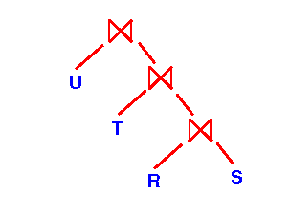
Solution: Join Order Estimation
A well-known problem since the 80’s
Extensively studied, lots of great algorithms published
Can these algorithms be used for CEP plan generation?
Join n relations on m attributes

Slide 36
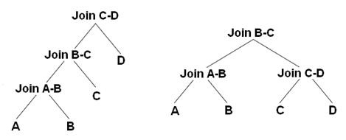
Join Query Plan Types
Left Deep Tree
(resembles NFA?)
Bushy Tree
(resembles CEP Trees?)

Slide 37
Commonly Used Cost Models
Join Plan Generation
Size of intermediate relations created during query evaluation
CEP Plan Generation
Number of partial matches created during pattern detection

Slide 38
Problem Equivalence = New Tools for CEP
Join Plan Generation Algorithms
Greedy
Dynamic Programming
Local Search
Graph Theory-based
Genetic Algorithms
Hybrid
Mixed Integer Programming

Slide 39
Are CEP patterns just another form of join queries?

Slide 40
Yes, for Conjunctive Patterns
Conjunctive CEP Plan Generation
Join Plan Generation

Slide 41
No, for all the rest
Disjunction
at least one of the specified events must occur
Sequence
all events must occur in the predefined order
Time Window
all events must occur within a predefined time period
Negation
some events cannot appear at specified positions
Kleene closure
some events may occur an unlimited number of times
Skip-Till-Next
an event can only participate in a single pattern match
Contiguity
all events must be contiguous in the input stream
Composition
arbitrary combinations of all of the above

Slide 42
Adapting Join Plan Generation Algorithms to General CEP Patterns
Non-Conjunctive CEP Plan Generation
Join Plan Generation
Reduction to Conjunctive

Slide 43
Join Cost Function
Represents the expected total number of intermediate tuples
Definitions:
- input relations
- join condition selectivity between
- cardinality of the relation
Cost of joining two relations:

Slide 44
Cost Function – Left-Deep Trees
Given an order L, such that
the cost function is:
where

Slide 45
Cost Function – Bushy Trees
Given a join tree T, the cost function is:
where

Slide 46
CEP Cost Function
Represents the expected number of partial matches simultaneously existing in memory with the time window
Definitions:
- event types participating in a pattern
- arrival rate (events per time unit of an event type
- selectivity of a condition between and
- time window defined by the pattern

Slide 47
Cost Function – Order-Based CEP
Given an evaluation order O, where
the cost function is:

Slide 48
Cost Function – Tree-Based CEP
Given an evaluation tree T, the cost function is:
where

Slide 49
Experiments – The Data
The algorithm was evaluated on the NASDAQ stock market historical data
An event represents an update to the price of a stock
Spanning a 1-year period
Over 2100 stock identifiers
80,509,033 events overall

Slide 50
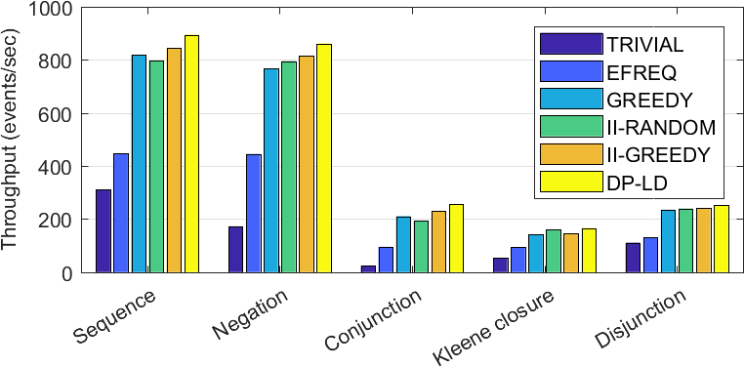
Experimental Results – NFA throughput

Slide 51
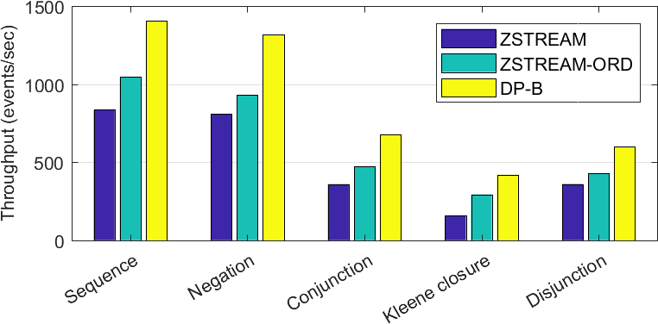
Experimental Results – Trees throughput

Slide 52
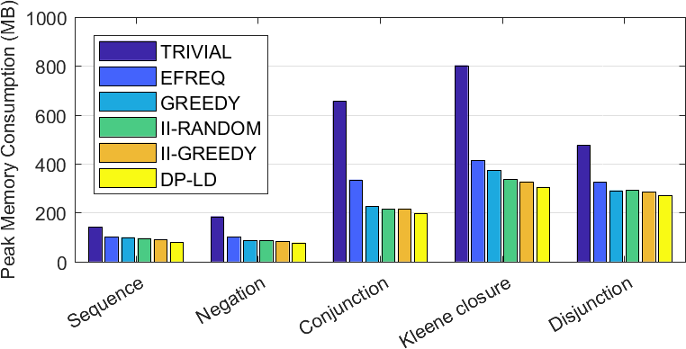
Experimental Results – NFA memory consumption

Slide 53
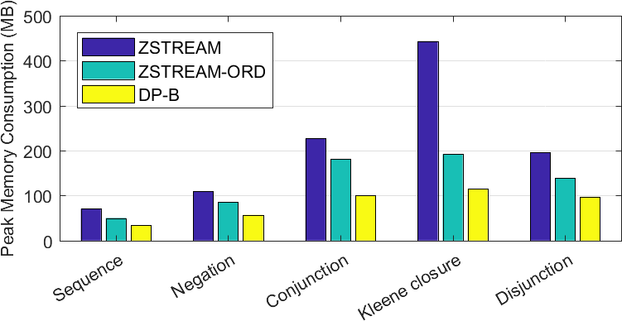
Experimental Results – Trees memory consumption

Slide 54
Addressing Detection Latency
Cost model can be extended to include latency
Let the latency cost function for a plan P (will be defined shortly)
Then, a mixed cost function can be produced:
where:
is one of the functions defined above
is a trade-off parameter

Slide 55
Latency Cost Function
Let denote the last event type in the temporal order induced by the pattern
For sequences, this is just the last pattern type
For conjunctions, has to be found empirically
For disjunctions / nested patterns, compute the latency cost function separately for each clause and take the maximum

Slide 56
Latency Cost Function – Order-Based CEP
Given an evaluation order O, where
the cost function is:
where contains all events succeeding
according to the order O

Slide 57
Latency Cost Function – Tree-Based CEP
Given an evaluation tree T, the cost function is:
where:
contains all ancestor nodes of a leaf corresponding to in T
denotes the other child of the parent of

Slide 58
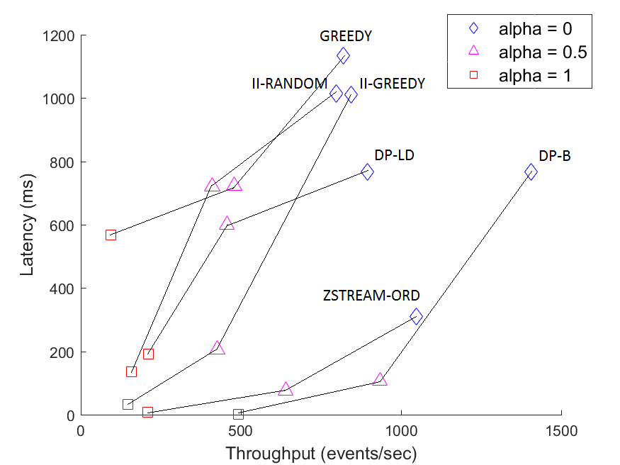
Throughput-Latency Tradeoff in Join Plan Generation Algorithms

Slide 59
adaptive cep

Slide 60
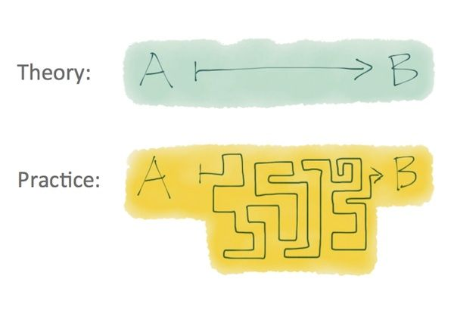
Data-Aware CEP in Practice
Will the data-aware method work in a real-life scenario?
Probably not
arrival rates / selectivities not known in advance
arrival rates / selectivities subject to frequent changes
Adaptation is needed

Slide 61
Adaptive CEP System
Input Stream(s)
Statistics Collector
Evaluation Mechanism
Handles pattern detection
Accepts up-to-date evaluation plans from optimizer
Responsible for deployment of new plans
Statistics
…
Collects incoming events
Estimates data statistics on-the-fly
event arrival rates
predicate selectivities
data distribution
Optimizer
New Evaluation
Plans
Pattern
Specifications
Plan Generation Algorithm
Accepts data statistics from the collector
Decides whether re-optimization is required
If needed, creates a new plan
Current
Evaluation Plan
Detected Pattern
Matches

Slide 62

Problem: existing adaptation decision strategies are insufficient
Periodically reoptimize the evaluation plan based on new statistics
Overhead-latency tradeoff ☹
Monitor all statistic values against a predefined threshold
Inaccurate, unstable ☹
Can we do better?

Slide 63
Monitoring against a constant threshold
100
85
65
55
85
T = 40
T = 10
False negative!
False positive!
rate(A)
rate(B)
rate(C)
C
B
A
SEQ(A a, B b, C c) WITHIN 10 minutes

Slide 64

Solution: Invariant-based Method
Monitor the relations between the statistics instead of the statistics themselves
Identify the relations that must constantly hold to guarantee plan optimality
i.e., invariants

Slide 65
Invariant-based Method: Initialization
rate(A) = 100
C
B
A
Applying a simple sorting algorithm…
Is rate(A) > rate(C)?
Is rate(B) > rate(C)?
Is rate(B) > rate(A)?
rate(B) = 50
rate(A)>rate(C)
rate(C) = 10
rate(B)>rate(C)
rate(A)>rate(B)
SEQ(A a, B b, C c) WITHIN 10 minutes

Slide 66
Invariant-based Method: Adaptation
rate(A) = 100
rate(A) = 20
rate(A) = 20
A
C
B
A
C
B
Recalculating evaluation plan and invariants…
rate(B) = 50
Invariants
rate(B)>rate(C)
rate(B)>rate(A)
rate(C) = 10
rate(A)>rate(B)
rate(A)>rate(C)
SEQ(A a, B b, C c) WITHIN 10 minutes

Slide 67

Benefits of the Invariant-Based Method
Computationally cheap
Provably avoids false positives
Drastically reduces the number of false negatives
Can be applied on any deterministic plan generation algorithm utilizing step-by-step building approach

Slide 68
Experiments – The Data
The algorithm was evaluated on the vehicle traffic sensor data
An event represents an observation of traffic at the given point
number of vehicles during the last 5 minutes
average speed
Collected over 4 months from 449 observation points
13,577,132 events overall

Slide 69
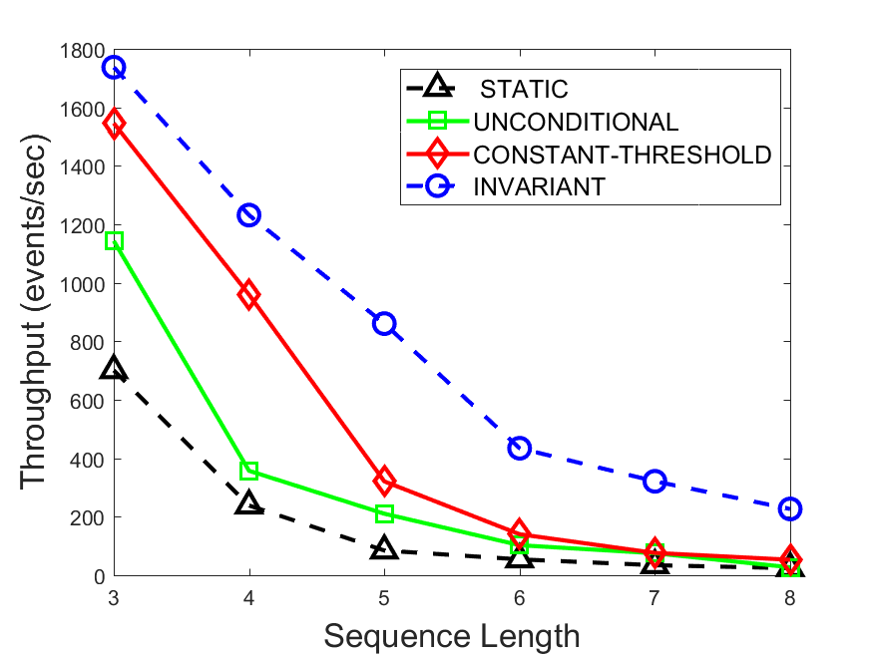
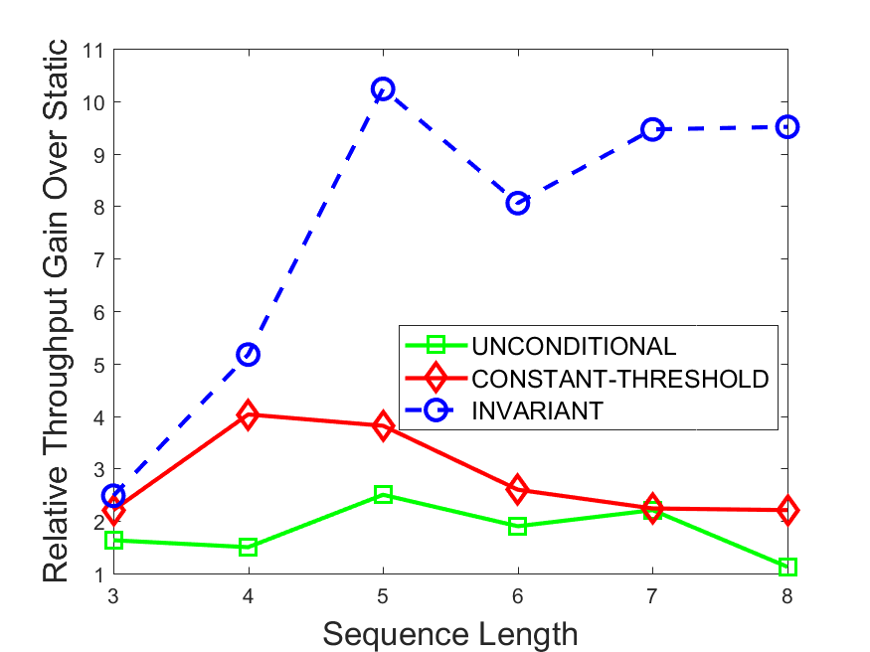
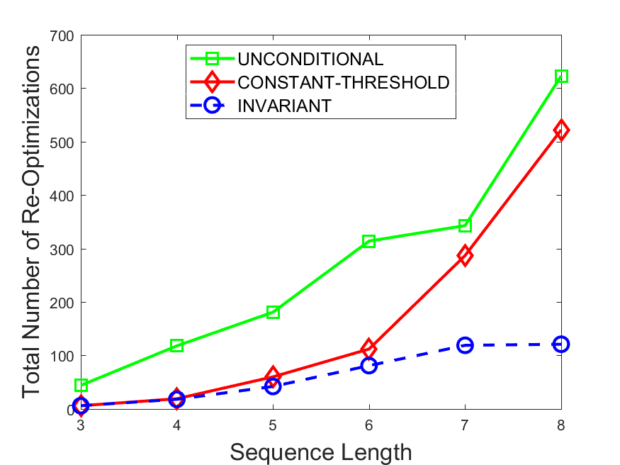
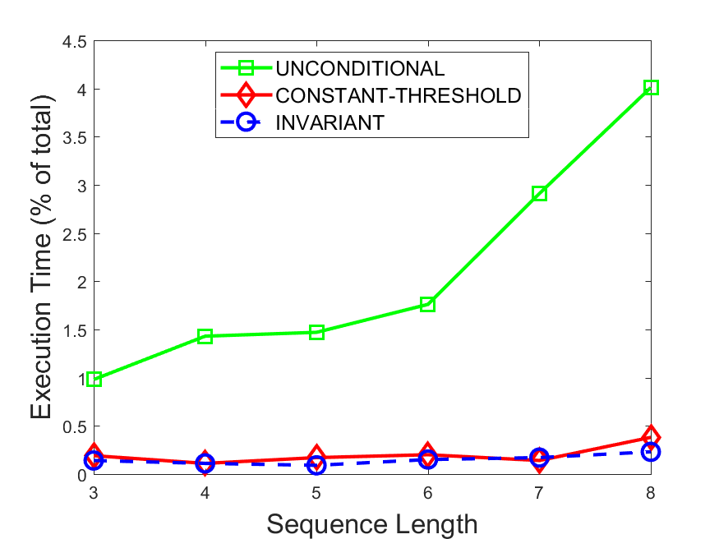
Experimental Results - NFA

Slide 70
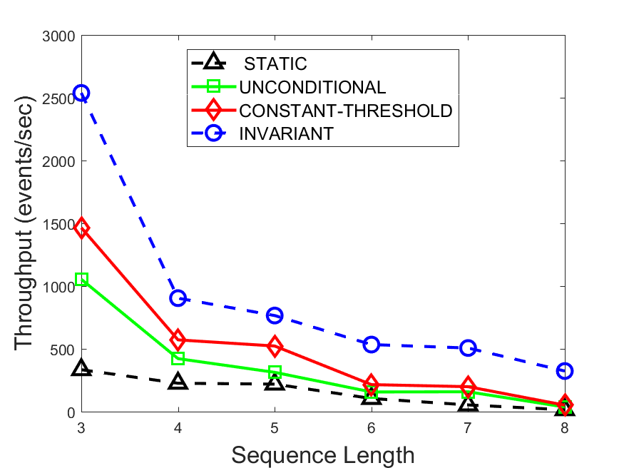
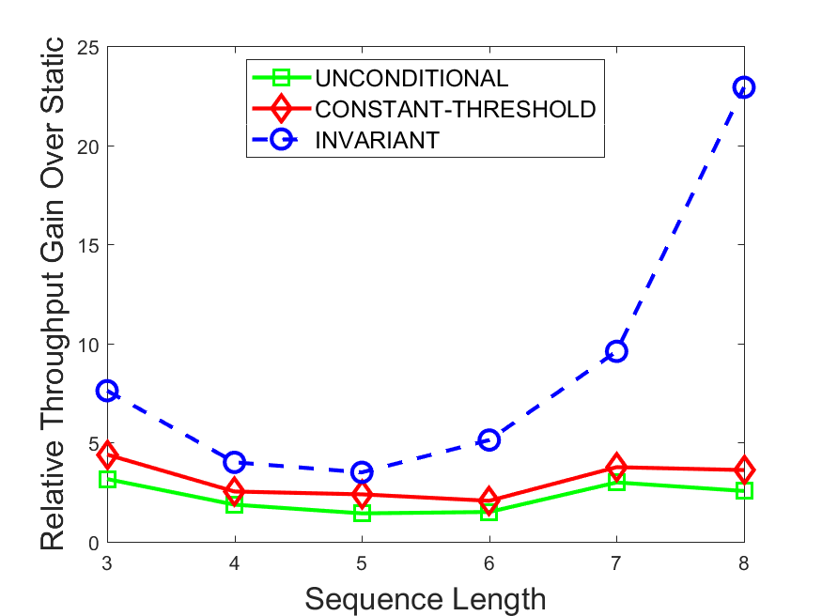
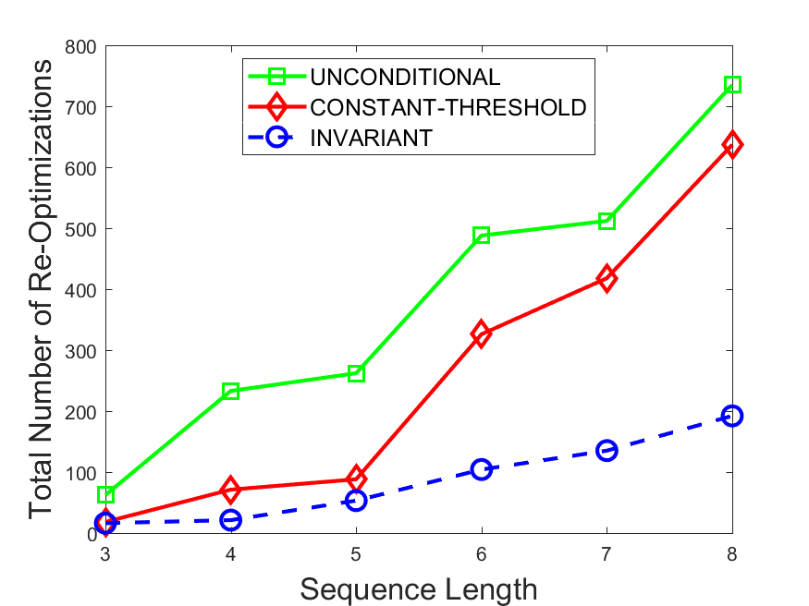
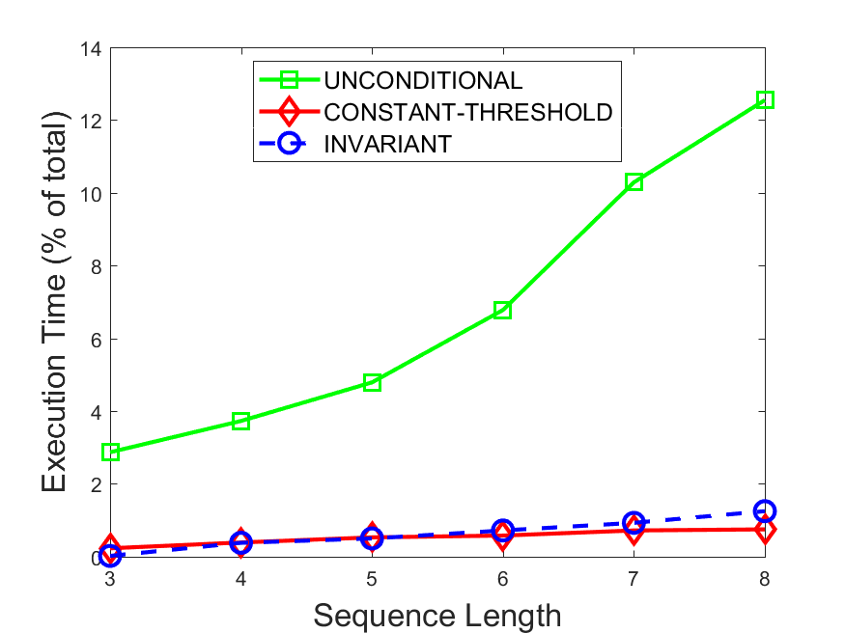
Experimental Results - Trees

Slide 71
multi-pattern cep

Slide 72
Real-life CEP Systems
Hundreds or thousands of patterns
Some patterns share similar subexpressions
Independent evaluation of each pattern is unrealistic
Input Stream(s)
P₁
CEP Engine
P₂
P₃
P_{n}
P₁ Matches
P₂ Matches
P_{n} Matches

Slide 73
Sharing Techniques for MCEP (NFA)
A
B
C
D
B
A
E
A
E
C
F

Slide 74
Sharing Techniques for MCEP (Trees)
Root₁
Root₂
ABCD
E
F
BCD
A
BCD
BC
D
BC
D
C
B
C
B

Slide 75
Data-Aware Sharing for MCEP
A
B
C
D
C
B
B
A
C
E
A
E
C
F
C
E

Slide 76
Problem: conflicting optimization goals
A
B
C
D
better individual performance of pattern detection
A
C
B
D
better resource sharing between different patterns

Slide 77
Solution: a Holistic Approach to Multi-Pattern Plan Generation
Extend the cost model to multiple patterns
from NFAs to MPTs (multi-pattern trees)
from trees to MPMs (multi-pattern multitrees)
Solve the resulting optimization problem with a combination of sharing and reordering

Slide 78
Cost Function – Multi-Pattern Trees (1)
From the order-based cost function we can derive the cost of the k^{th} state in a chain-structured NFA ordered according to the order O:

Slide 79
Cost Function – Multi-Pattern Trees (2)
Given a node N in the multi-pattern tree MPT, let be the path from the root of MPT to N
By definition of a tree, there is always exactly one such path
The cost of MPT is the defined as follows:

Slide 80
Cost Function – Multi-Pattern Multitrees (1)
Recall that for an evaluation tree T, the cost function is given by the sum of costs of the tree nodes, defined as follows:

Slide 81
Cost Function – Multi-Pattern Multitrees (2)
For a multi-pattern multitree MPM, we apply the same formula by iterating over all nodes in MPM and summing up their individual costs:

Slide 82
Problem: Hyperexponential number of possible solutions
Given a workload of n patterns, there are at least possible MPTs, where is the size of i^{th} pattern
How do we select the most efficient plan out of this enormous space?
!
X
!
X
!
X

Slide 83
And even more possible MPMs…
Root₁
Root₂
Root₃
A,B
C,D
E,F
G,I
A
B
C
D
E
F
G
I

Slide 84
Solution: Local Search
Start with some initial solution
Traverse the solution space until the time expires
Return the best observed solution
A perfect tradeoff between plan quality and optimization time
?

Slide 85
Solution (Part 1): Reducing the Solution Space
shared part
non-shared part
Selected for sharing with other patterns
(1)Partition the evaluation order into a shared and a non-shared part
(2)Calculate the most efficient orders for the shared and the non-shared part

Slide 86
Solution (Part 2): Local Search
Start with some initial solution
Traverse the solution space until the time expires
Return the best observed solution
A perfect tradeoff between plan quality and optimization time
?

Slide 87
Neighbor Selection Process (MPT)
shared
shared
shared
shared
shared
shared
(3)Calculating new individual plans allowing the new sharing (may affect previously shared subpatterns)
(2)Selecting target patterns
(1)Selecting a non-shared common subpattern
(4)Modifying the MPT with the branches corresponding to the new individual plans

Slide 88
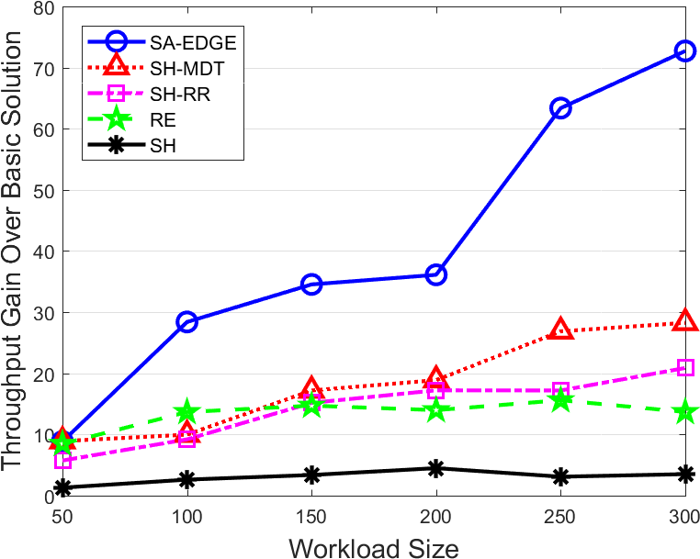
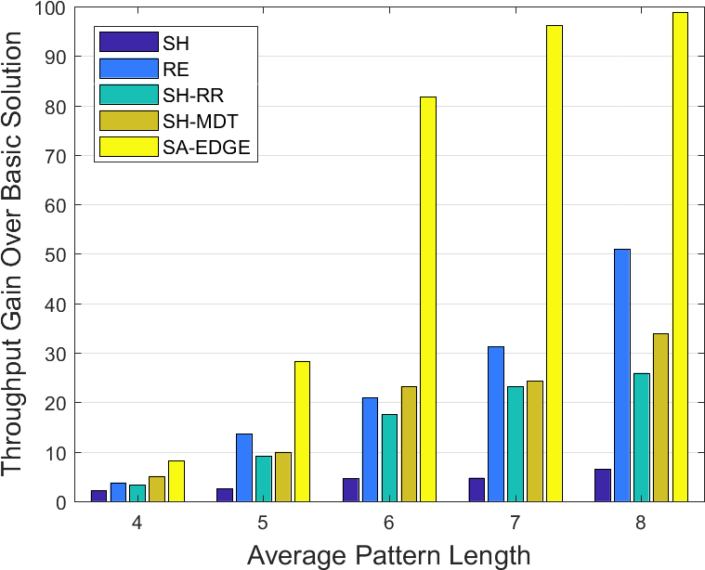
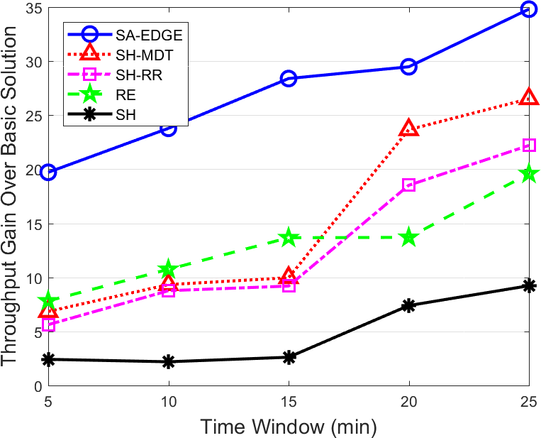
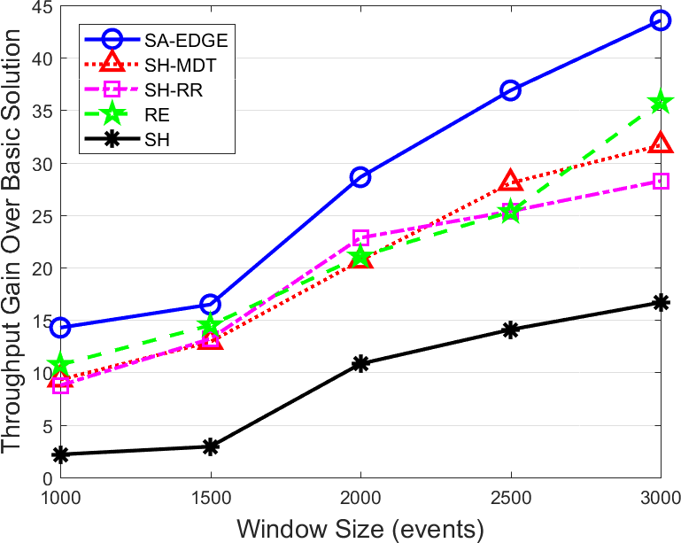
Experimental Results

Slide 89

Advanced MCEP Features
SLA-Aware MCEP
Adaptive MCEP
MCEP with workload modification

Slide 90
SLA-Aware MCEP

Slide 91
Summary
Incorporating data statistics allows a CEP system to achieve a performance boost of up to several orders of magnitude
Detection latency and memory consumption are also significantly improved
Many open questions remain
parallel and distributed CEP
operating under uncertainty
and many more

Slide 92
Questions?

